Slide 1


Slide 2

E-Office
Benefits
Facilitate the management of incoming and outgoing mail electronically
Improving the efficiency and effectiveness of the management of correspondence and public services
Accelerate the management of Office Manuscripts Electronically
Realizing an effective and efficient modern bureaucracy at SESKOAL
Intended to facilitate the management of correspondence documents and online office activities.

Slide 3
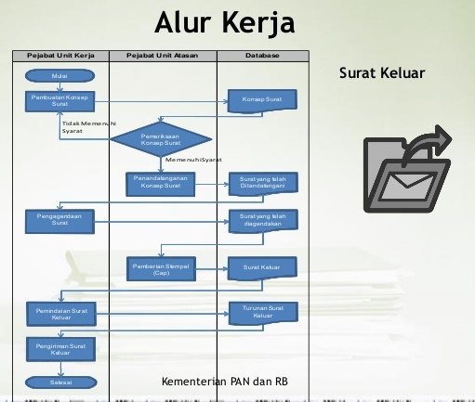
E-Office Application
The flow process of managerial script in the work environment,
So it can create a less-paper work environment.
Accessible both from
workstations and from
smartphones and tablets.

Slide 4
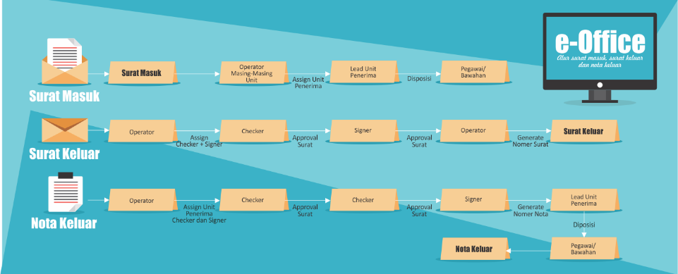

Slide 5

E-Office Application
Features
Mail Management
Correspondence
Disposition
Mail Expedition
Internal Mail
Circular letter
Memo
Draft & Templating
Workflow Manager

Slide 6




